Slide 1


Presentation on Sequential circuit
Submitted by:
-Rishi Khadka
-Pradhumna Adhikari
-Pramod Karki
-Sajak Shrestha

Slide 2
Table of content:
Sequential circuits
Types of flipflops
Design of sequential circuit with state diagram and state table
Design of Sequential Circuit with State Equation

Slide 3
Sequential Circuit
-Sequential circuit is a circuit in which the present output not only depends upon the current input but also in the previous output.
-It may or mayn’t contain a clock input.
Input
Output
Feedback path
Memory
element
Fig: Block diagram of sequential circuits

Slide 4
Types of sequential circuits:
There are two types of sequential circuits:
Synchronous sequential circuits.
Asynchronous sequential circuits.

Slide 5
Flip-Flop
Flip-flops is a memory element which is capable of storing one bit of information and it is used in clock sequential circuits.
A flip-flop has two outputs, one for normal value and other for complement value of the bit stored in it.
There are four basic types: SR, JK, D and T flip-flops.

Slide 6
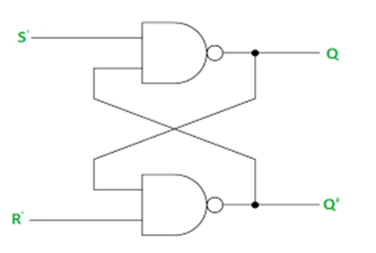
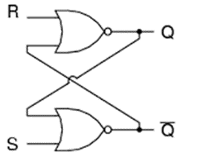

Basic Flip-flop
A flip-flop circuit can be constructed from two NAND gates or two NOR gates.
Fig: Basic Flip-flop circuit with NAND Gate
Fig: Basic Flip-flop circuit with NOR Gate
TRUTH TABLE
TRUTH TABLE
S | R | Q | Q
0 | 0
0 | 1 | 0 | 1
1 | 0 | 1 | 0
1 | 1
S | R | Q | Q
0 | 0
0 | 1 | 0 | 1
1 | 0 | 1 | 0
1 | 1
Memory
Invalid
Invalid
Memory

Slide 7
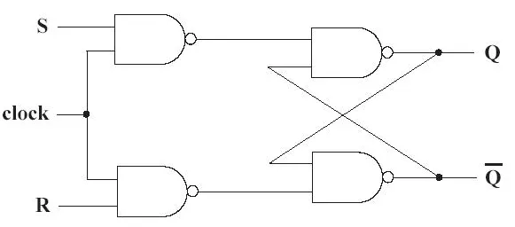
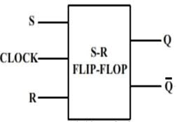
Clocked SR Flip-Flop
The clocked SR flip-flop consists of basic NAND latch and two other NAND gates to provide clock pulse
Clock pulse is used for the synchronization and act as an additional control input.
Fig: Logic Diagram
Graphic symbol

Slide 8
Characteristic table
Q | S | R | Q(t+1)
0 | 0 | 0 | 0
0 | 0 | 1 | 0
0 | 1 | 0 | 1
0 | 1 | 1 | x
1 | 0 | 0 | 1
1 | 0 | 1 | 0
1 | 1 | 0 | 1
1 | 1 | 1 | x
S’R’
S’R
SR
SR’
Q’
 |  | x | 1
1 |  | x | 1
Q
Characteristic Equation
Q(t+1)= S + QR’

Slide 9
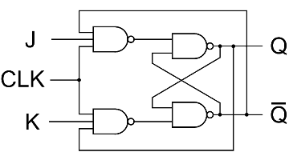
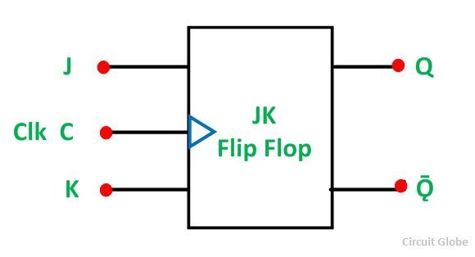
JK Flip-Flop
A JK flip-flop is a refinement of the SR flip-flop to solve the problem of indeterminate state when both inputs are 1.
In JK flip-flop J and K are like S and R to set and Reset the flip-flop.
Fig: Logic Diagram
Graphic symbol

Slide 10
Characteristic table
Q | S | R | Q(t+1)
0 | 0 | 0 | 0
0 | 0 | 1 | 0
0 | 1 | 0 | 1
0 | 1 | 1 | 1
1 | 0 | 0 | 1
1 | 0 | 1 | 0
1 | 1 | 0 | 1
1 | 1 | 1 | 0
J’K’
J’K
JK
JK’
Q’
 |  | 1 | 1
1 |  |  | 1
Q
Characteristic Equation
Q(t+1)= Q’ J+ QK’

Slide 11
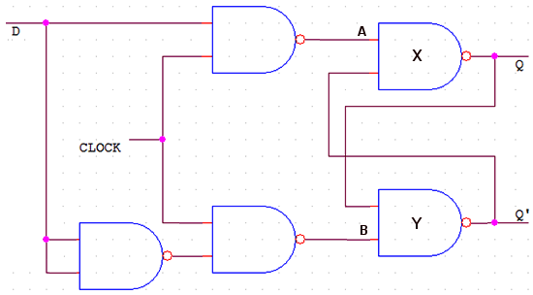
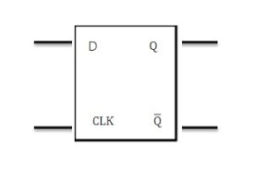
D Flip-Flop
D Flip-flop is the modification of clocked SR flip-flop.
Fig: Logic Diagram
Graphic symbol

Slide 12
Characteristic table
D’
D
Q(t) | D | Q
0 | 0 | 0
0 | 1 | 1
1 | 0 | 0
1 | 1 | 1
Q’(t)
 | 1
 | 1
Q(t)
Characteristic Equation
Q(t+1)= D

Slide 13
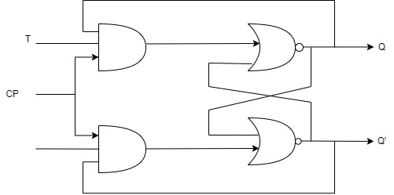
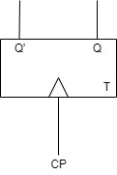
Triggering of Flip-flops
T flip flop is a type of flip flop made by shorting J and K input of JK flip flop to single input T. The output Tuggles each time for T=1.
Fig: logic diagram Graphic symbol

Slide 14
Q | T | Q(T+1)
0 | 0 | 0
0 | 1 | 1
1 | 0 | 1
1 | 1 | 0
T
Q
 | 1
1
Q(t+1)=TQ’ T’Q
Characteristic table
Characteristic equation

Slide 15
State Table
The information contained in the state diagram is transformed into a table called a state diagram. It consist of three section labeled present state, next state, output .
Present state | Next state |  | output
 | X=0 | X=1 | X=0 | X=1
AB | AB | AB | y | Y
00 | 00 | 01 | 0 | 0
01 | 11 | 01 | 0 | 0
10 | 10 | 00 | 0 | 1
11 | 10 | 11 | 0 | 0

Slide 16
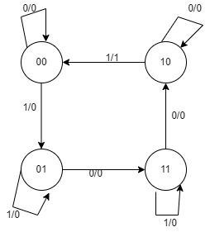
State Diagram
The information in a state table may be represented graphically in a state diagram. In a diagram state is represent by the circle and the transition between state is indicated by the directed line connecting the circle.

Slide 17
Design of sequential circuit with state diagram & state table
Present state |  | Next state |  | output
 |  | X=0 | X=1 | X=0 | X=1
A | B | AB | AB | Y | Y
0 | 0 | 00 | 01 | 0 | 0
0 | 1 | 11 | 01 | 0 | 0
1 | 0 | 10 | 00 | 0 | 1
1 | 1 | 10 | 11 | 0 | 0
K-map simplification
BX
BX
BX
A
A
 |  |  | 1
1 |  | 1 | 1
A
 | 1 | 1 | 1
 |  | 1
 | 1
N A=BX’+AB+AX’
N B=A’B’X+A’B+BX
Y=AB’X

Slide 18
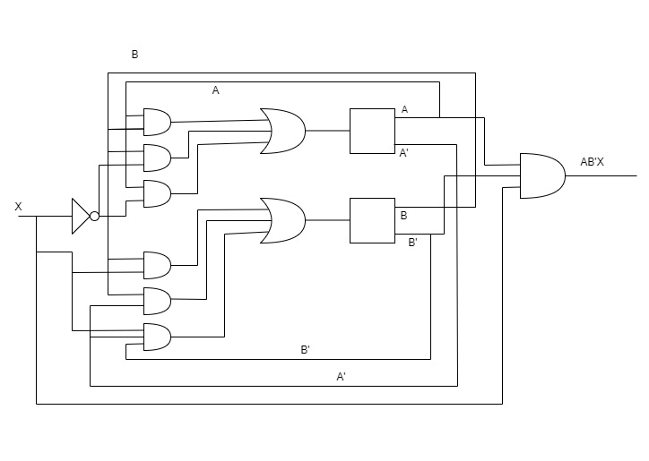
Circuit

Slide 19
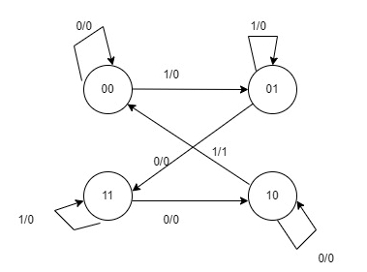
State diagram

Slide 20
TO DESIGN A SEQUENTIAL CIRCUIT WITH JK FLIP FLOP TO SATISFY THE FOLLOWING STATE EQUATION
A t+1 = A’B’CD + A’B’C + ACD + AC’D’
B t+1 = A’C + CD’ + A’BC
C t+1 = B
D t+1 = D’

Slide 21
Input of flipflop A can be determined by comparing A t+1 = C Ꚛ D with characteristics equation of JK FF.
We have C.E of JK FF = Q t+1 = Q’t J + Qt K’
A t+1 = C’D + CD’
= C’D( A + A’) + CD’ (A + A’)
= C’DA + CD’A + C’DA’ + CD’A’
= (C Ꚛ D) A + ( C’D Ꚛ CD’) A’
= (C Ꚛ D)A’ + ( C Ꚛ D ) A
JA = C Ꚛ D
K’A = C Ꚛ D
KA = ( C Ꚛ D )’

Slide 22
Similary,
B(t+1)=A C(T+1)=B
=A+0.B =B(C+C’)
=A(B+B’)+O.B =BC+BC’
=AB+AB’ =C’B+CB
=AB’+AB
JC=B K’C=B=B’
JB=A K’B=A=A’
D(T+1)=C
=C(D+D’)
=CD’+CD
JD=C
K’P=D=D’

Slide 23
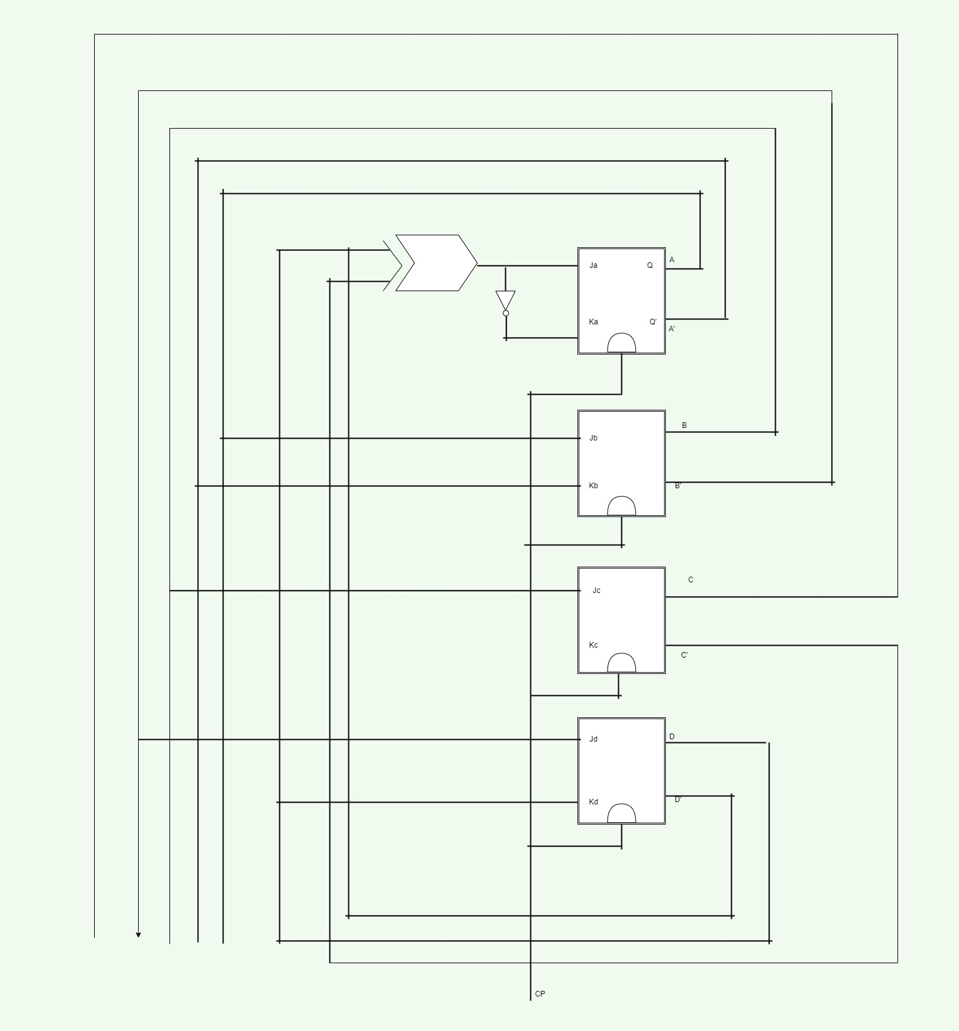
Fig: Circuit digram

Slide 24

Thankyou…

